Slide 1
Secure Data Hiding in Image Using Steganography
CAPSTONE PROJECT
Presented By: B.AVINASH
NAME: AVINASH BAYYA
SKILLBUILD EMAIL ID: avinashbayya3134@gmail.com
COLLEGE NAME: NRI Institute of Technology
BRANCH: CSE
PLACE: Guntur, ANDHRA PRADESH

Slide 2
OUTLINE
Problem Statement
Technology used
Wow factor
End users
Result
Conclusion
Git-hub Link

Slide 3
Problem Statement
∗ The increasing volume of digital data necessitates secure and covert communication methods to protect sensitive information from unauthorized access.
∗ Traditional encryption methods, while effective, can attract unwanted attention due to their conspicuous nature.
∗ There is a need for robust steganographic techniques that can effectively conceal data within digital images without causing noticeable degradation.
∗ Existing steganographic methods often lack a balance between capacity, imperceptibility, and security, making them vulnerable to detection.
∗ This project aims to develop a novel steganographic algorithm that enhances data security and imperceptibility while maximizing the data hiding capacity within images.

Slide 4
What is Image Steganography
Hiding Data
Invisible to the Eye
Secured
Communication
Image steganography involves embedding secret data, such as text, images, or even files, within the pixels of a digital image
The hidden data is concealed in a way that it is undetectable to the casual observer, making the image appear normal and unaltered.
This technique allows for secure communication, as the existence of the hidden data is hidden from anyone who is not aware of its presence.

Slide 5
Technology used
Pillow: FOR IMAGE MANIPULATION
Pillow: For image manipulation.
INSTALL
Pillow: For image manipulation.
OpenCV: For advanced image processing.
Pillow: For image manipulation.
NumPy: For numerical operations.

Slide 6
Wow factors
Key Areas for Innovation:
Enhanced Security:
Adaptive encryption, secure key distribution, and combined steganography-cryptography.
Increased Capacity:
Optimized pixel selection and advanced frequency domain adaptations.
Improved Imperceptibility:
Perceptual masking and statistical analysis resistance.
Automation and User Experience:
Automated steganalysis detection and user-friendly interface.
In essence, unique features arise from:
Sophisticated algorithms that go beyond basic LSB techniques.
A strong emphasis on security through robust encryption and key management.
Techniques that prioritize imperceptibility, making the hidden data virtually undetectable.
By combining these elements, a steganography project can offer a significant advancement over existing methods.

Slide 7
End users
The primary end users for this steganography project include government and military personnel secure communication, corporate executives protecting proprietary data, and journalists sharing sensitive information discreetly.
IT and cyber security teams can integrate this technique to enhance organizational data security.
Additionally, the person who wants to send any secret message other person in a hidden format then this project will helpful for them.

Slide 8
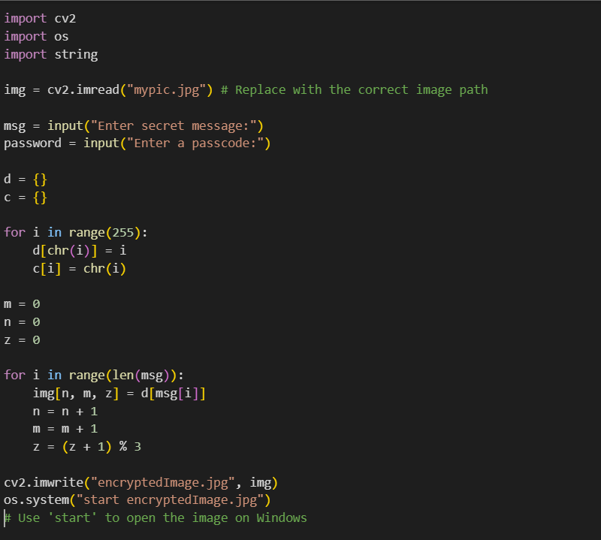
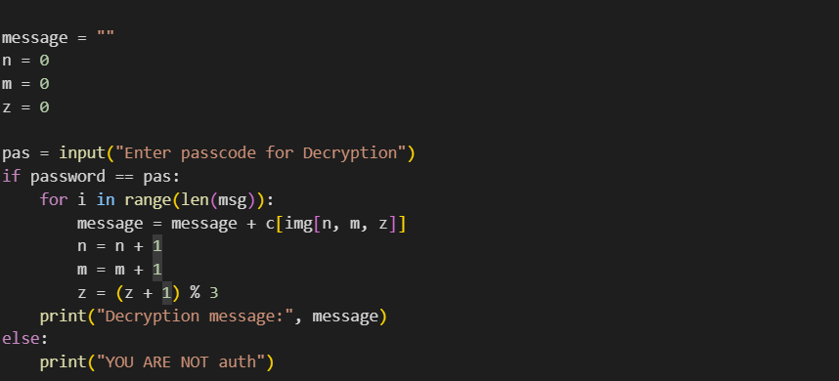
code :

Slide 9
Results
IMAGE ENCRYPTION
IMAGE DECRYPTION

Slide 10

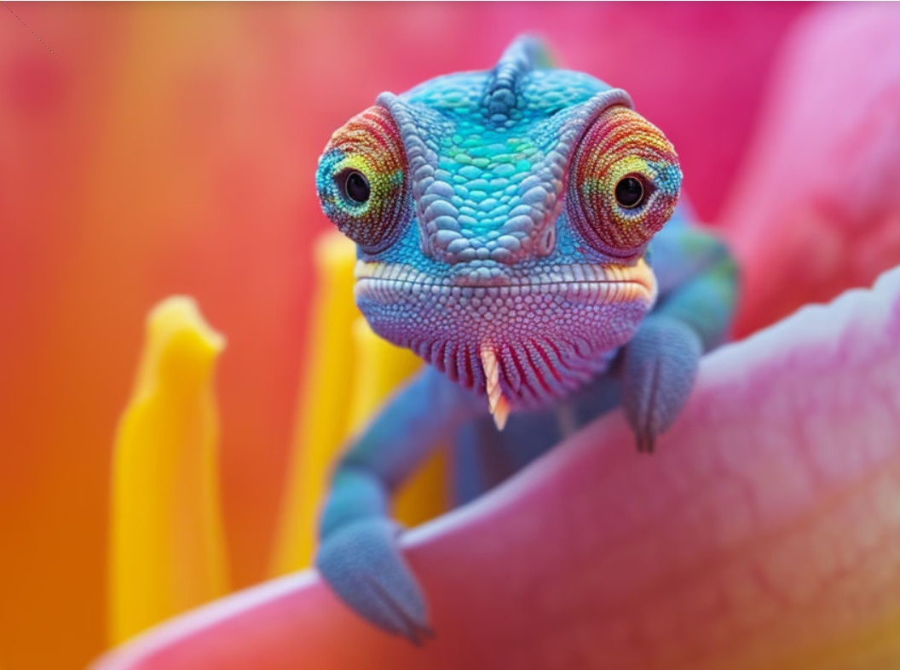
ORIGINAL IMAGE
ENCODED IMAGE

Slide 11
Conclusion
In conclusion, the project "Secure Data Hiding in Image Using Steganography" successfully demonstrates a method to enhance data security by embedding confidential information within digital images. This technique ensures that sensitive data remains concealed and protected from unauthorized access, offering an added layer of security for digital communication. Through this project, we have highlighted the potential of steganography as an effective tool for secure data transmission in the digital age.

Slide 12
GitHub Link
https://github.com/AvinashBayya/Secure-Data-Hiding-in-Image-Using-Steganography

Slide 13
THANK YOU

